Slide 1
Day 2
The Angular App

Slide 2
Contents
Types of Applications in Angular
Modularity in Angular
Dynamic and Eager Loading
Getting into the ‘Core’ Module - creating components
app.component.html
app.module.ts
Running the app
Passing Data between Components
Data Binding: Interpolation
Adding global styles
Pipes

Slide 3
Types of Applications in Angular: Standalone vs. Module-Based
Angular supports two types of application architectures:
  Standalone Application (introduced in Angular 14)
  Module-Based Application (traditional approach)
Each has its advantages based on project requirements.

Slide 4
Standalone
Think of this as a "direct" way of building an Angular app.
You don’t need to create modules (NgModule).
Every component, directive, or pipe can stand on its own and directly import what it needs.
It makes things simpler and is faster for smaller projects.
Best for: Small to medium projects, or when you want a simpler structure.

Slide 5
Module Based
This is the old-school method where everything is organized into modules (NgModule).
You must define an AppModule, which acts as the main container for all components, directives, and services.
Helps in managing large applications by grouping related features into different modules.
Best for: Large applications where you need better organization and modularity.

Slide 6
Step 1
Create a new folder ‘Angular_Applications’ --> open in integrated terminal
npx @angular/cli@19 new UserProject --no-standalone
npx runs the specified package (here, @angular/cli version 19) without globally installing it.
@angular/cli@19 ensures that Angular CLI version 19 is used to create the project.
new is a command provided by Angular CLI to create a new Angular project.
UserProject is the name of the new project directory.
--no-standalone flag instructs Angular CLI not to generate a standalone application.
Right click on newly created project and open in integrated terminal.

Slide 7
Modularity in Angular
A Module in Angular is a container that organizes components, directives, pipes, and services.
Every Angular application has at least one module: AppModule (app.module.ts).
Modules help in structuring and managing large applications efficiently.
Types of Modules in Angular:
  Root Module (AppModule) – The main module that bootstraps the application.
  Feature Modules – Used for organizing related components (e.g., UserModule, ProductModule).
  Core Module – Contains singleton services (e.g., authentication, logging).
  Shared Module – Stores common components, directives, and pipes used across multiple modules.

Slide 8
Key Benefits of Using Modules
✅ Better Organization – Helps in maintaining code structure.
✅ Lazy Loading – Improves performance by loading modules only when needed.
✅ Reusability – Feature modules can be reused across applications.
✅ Separation of Concerns – Each module handles a specific functionality.

Slide 9
Step 2
Let’s create modules: Core, Shared, Profiles, Dashboard & Auth
npx ng g m core
npx ng g m shared
npx ng g m profiles --routing
npx ng g m dashboard --routing
npx ng g m auth --routing

Slide 10
Creating Modules - Eager Loading
npx ng g m core
npx – Runs a package without installing it globally.
ng – The Angular CLI command-line tool.
g (or generate) – Generates a new Angular entity (like a component, module, service, etc.).
m (or module) – Specifies that we are generating a new Angular module.
core – The name of the module being created (i.e., core.module.ts).

Slide 11
Creating Modules - Dynamic Loading
npx ng g m profiles --routing
npx – Runs a package without installing it globally.
ng – The Angular CLI command-line tool.
g (or generate) – Generates a new Angular entity.
m (or module) – Specifies that we are generating a new Angular module.
profiles – The name of the module being created (ProfilesModule).
--routing – Also generates a separate routing module (profiles-routing.module.ts) for handling navigation.

Slide 12
Getting into the ‘Core’ Module - creating components
Core Module will have the header, footer and landing page of the application which is basically the layout of the application.
Creating Components inside module:
npx ng g c core/components/layout/header
npx ng g c core/components/layout/footer
npx ng g c core/components/layout/landing

Slide 13
Creation of Components
npx ng g c core/components/layout/header
npx – Runs a package without installing it globally.
ng – Angular CLI command.
g (or generate) – Generates a new Angular entity.
c (or component) – Specifies that we are generating a new Angular component.
core/components/layout/header – The folder structure where the component will be created.

Slide 14
app.component.html
It is the main template (view) for the root component (AppComponent) in an Angular application.
Defines the UI structure for the entire application.
Used to include other components, such as headers, footers, navigation, and main content.

Slide 15
Step 3: Updating app.component.html
Go to app.component.html --> remove exisiting content and add the roots for overall layout as follows:
<app-header></app-header>
<app-landing></app-landing>
<app-footer></app-footer>
There is an error: since there is no relationship between AppModule and CoreModule which we need to set.

Slide 16
app.module.ts
app.module.ts is the root module of an Angular application. It is a crucial part of the Angular framework because it defines the structure of the application, organizes components, and manages dependencies.
Key Points:
  Module Container: It acts as a container for the different parts of your Angular app (components, services, pipes, and directives).
  Bootstraping: It defines the root component (usually AppComponent) that Angular uses to bootstrap (start) the application.

Slide 17
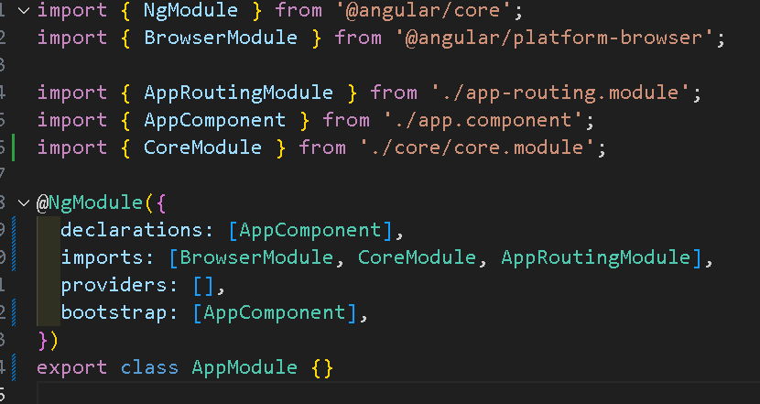
Step 4: Setting the relationship between AppModule and CoreModule
Go to app.module.ts -->
@NgModule is a decorator used to define metadata for the module. It tells Angular how to compile and launch the application.
The error still persists on app.component.html.. check!

Slide 18
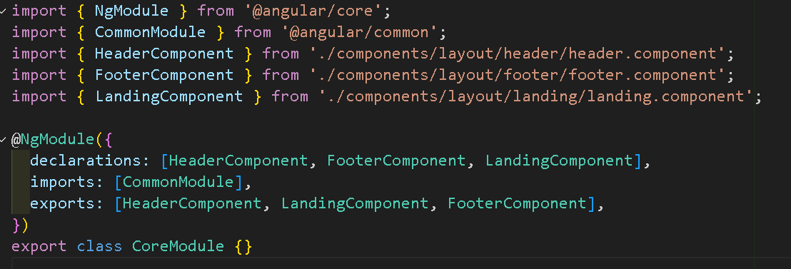
Step 5: Exporting modules in Core
Go to core.module.ts -->

Slide 19
Step 6: Running the app
npx ng serve
npx – Runs a package without installing it globally. It executes the Angular CLI command (ng) directly without needing a global Angular CLI installation.
ng – The Angular CLI (Command Line Interface) tool used to interact with Angular applications.
serve – A command that compiles the Angular app and serves it on a local development server, usually at http://localhost:4200.
To end the running --> Ctrl + C on Command prompt of VS
if port is busy: npx ng serve --port 5600

Slide 20
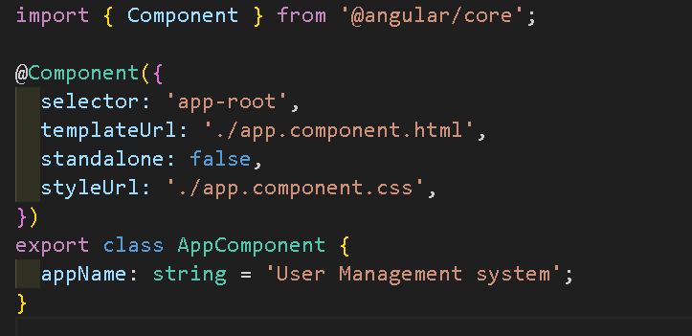
Step 7: Passing Data between Components
Ex: Passing name of application to header and footer components
Let’s start with header component:
app.component.ts --> change the title property to: -->

Slide 21
Passing Data between Components
2. Go to app.component.html -->
<app-header [applicationName]="appName"></app-header>
3. Go to header.component.ts --> inside class add:
@Input()
applicationName: string = ' ';
The @Input() decorator marks a property as input-bound, meaning the value of the property can be set by the parent component.

Slide 22
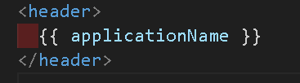
Passing Data between Components
4. Go to header.component.html -->
5. Repeat the same for footer

Slide 23
Data Binding: Interpolation
Interpolation in Angular is a data binding technique used to embed expressions inside the template HTML.
It allows you to display dynamic data or expressions from your component class into your template.
The {{ }} syntax is used for interpolation in Angular.
The expression inside the curly braces is evaluated and the result is displayed in the HTML view.
When to Use Interpolation?
  Display values of variables.
  Call methods and display their results in the template.
  Dynamically insert content into your HTML elements.

Slide 24
Step 8: Adding global styles
In the application --> src-->styles.css
Add the style code inorder to apply styles globally
Code given on GCR.
Add a folder assets in src
add background image url as per the image url
edit the same in styles.css

Slide 25
Step 9: Adding html codes to Core
Add html code to header.component.html (GCR)
Add html code to landing.component.html

Slide 26
Pipes
In Angular, pipes are a useful feature that allows you to transform data in templates.
They are simple functions that accept an input value, process it, and return a transformed output.
Pipes are commonly used for formatting dates, numbers, filtering, and other transformations within the template.

Slide 27
Types of Pipes
Angular provides several built-in pipes, such as:
  DatePipe: Formats date values.
  CurrencyPipe: Formats numbers as currency.
  UpperCasePipe: Converts text to uppercase.
  LowerCasePipe: Converts text to lowercase.
  JsonPipe: Transforms an object into a JSON-formatted string.
  PercentPipe: Formats a number as a percentage.

Slide 28
Step 10: Using Pipe for Date on footer
Go to footer.component.ts--> in the class --> add:
currentDate: Date = new Date();
Go to footer.component.html --> add:
<footer>
&copy; {{ applicationName }} {{ currentDate | date : "yyyy-MM" }}
</footer>

Slide 29
Other Date Format and Pipe
{{ currentDate | date:'dd-MM-yyyy' }}
→ 10-03-2025
{{ currentDate | date:'fullDate' }}
→ Monday, March 10, 2025
{{ currentDate | date:'shortDate' }}
→ 3/10/25

Slide 30
Day 3
The Angular App cont…Login and Registration Pages

Slide 31
Contents
Auth Module
Steps for Connection between Core and Auth Module
Setting routes to Login and Register
Upgrading Register/Login Component
Validators in Angular
ngIf: Angular If

Slide 32
Steps for Connection between Core and Auth Module
Creation of Login and Register Components:
Step 1: Create login and register components under auth module:
npx ng g c auth/components/auth/register
npx ng g c auth/components/auth/login

Slide 33
Recollect!
What is app-routing.module.ts?
It is the file where you define all the URL paths (routes) for your Angular application. It maps each URL to a specific component, acting like a navigation guide that tells Angular which component to display when a user visits a particular URL.
2. What is app.module.ts?
In simple words, app.module.ts is the main configuration file of your Angular application. It acts like a blueprint, bringing together all the building blocks of your app by declaring components, directives, and pipes, while also importing essential modules (such as BrowserModule and RouterModule) that provide necessary functionalities. Additionally, it specifies which component should launch when the app starts, effectively serving as the central hub that wires up and configures your entire application.

Slide 34
Step 2: Setting routes to Login and Register
Go to app-routing.module.ts: add const routes
const routes: Routes = [
{
path: '',
component: LandingComponent,
},
{
path: 'auth',
loadChildren: () => import('./auth/auth.module').then((m) => m.AuthModule),
},
];

Slide 35
Step 2: Setting routes to Login and Register
const routes: Routes
It is a declaration that creates a constant variable named routes and specifies that its type is Routes.
In Angular, Routes is an array that holds your route configuration objects, which define how URL paths map to components in your application.

Slide 36
Setting routes to Login and Register
The first route:
path: '' (empty string), represents the default route when the application loads.
This route maps to LandingComponent, meaning that when the user visits the base URL (e.g., http://localhost:4200/), Angular loads LandingComponent.
The second route:
path: 'auth': This means that any URL that starts with /auth will be handled by this route.
loadChildren: This is used for lazy loading, meaning that the AuthModule will only be loaded when the user navigates to the /auth route.
import('./auth/auth.module').then((m) => m.AuthModule): This syntax dynamically imports the AuthModule, which helps improve performance.

Slide 37
Step 3: Adding RouterModule in app.module
What is RouterModule?
"RouterModule" is part of Angular’s router package. It provides routing features, letting you navigate between components in your Angular app.
It lets you:
Define Routes: Map URLs to components.
Navigate Between Views: Use directives like [routerLink] and <router-outlet> to move between different pages or views without reloading the page.
Configure Routing: Set up routing with methods like RouterModule.forRoot() or RouterModule.forChild().
In short, it manages the navigation logic of your Angular application.

Slide 38
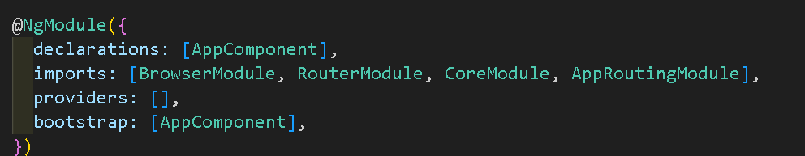
Step 3: Adding RouterModule in app.module
Go to app.module.ts: in the imports array:
Add RouterModule (before AppRoutingModule)
  RouterModule: Enables routing functionality to define application navigation.

Slide 39
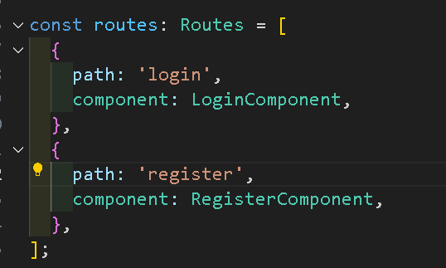
Step 4: Add routes to auth-routing.module.ts
Add routes of login and register component:
const routes: Routes = [
{
path: 'login',
component: LoginComponent,
},
{
path: 'register',
component: RegisterComponent,
},
];

Slide 40
Step 5: html file updates
Go to app.component.html:
update <app-landing> to <router-outlet></router-outlet>
  The <router-outlet> directive is a placeholder where Angular dynamically loads and displays components based on the current route.
Go to header.component.html: update a href to :
<li><a [routerLink]="['/auth/register']">Register</a></li>
<li><a [routerLink]="['/auth/login']">Login</a></li>
  [routerLink] is an Angular directive that binds a component’s route to a clickable link.
  When the user clicks on the link, Angular navigates to the corresponding route without reloading the rest of the page.

Slide 41
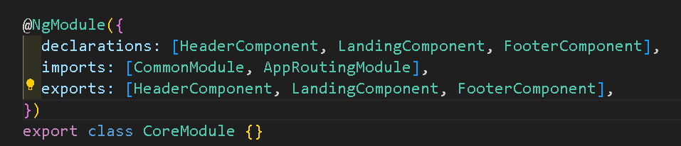
Step 6: Add Dynamic routing to Core Module
Go to core.module.ts -->
add AppRoutingModule in imports array declaration as follows:

Slide 42
Actual Look and feel of Register/Login Component
Add html code to register.component.html & login.component.html from GCR day 3 codes.
Check if your application is navigating from Landing page to Login and Register and both the pages have the web elements in their display!!

Slide 43
ReactiveFormsModule
In Angular, form validation is handled using Reactive Forms and Form Validators.
ReactiveFormsModule is an Angular module that helps you build and manage forms in a more structured way using code. Instead of relying solely on the template, you define the form's structure, validation, and behavior in your component using TypeScript.
ReactiveFormsModule is an alternative to the FormsModule in Angular.
While FormsModule supports template-driven forms, where most of the logic and validation is handled in the HTML template, ReactiveFormsModule lets you manage the form's structure and logic entirely in your TypeScript code, offering a more robust and scalable approach for complex form scenarios.

Slide 44
ReactiveFormsModule
Inside the ReactiveFormsModule, you’ll find all the tools you need to build and manage reactive forms in Angular. This includes:
Classes for Building Forms:
  FormControl: Represents a single form control (input field).
  FormGroup: Groups multiple form controls into a single unit.
  FormArray: Manages an array of form controls.
  FormBuilder: A service that helps you create form controls and groups more easily.

Slide 45
Example for Classes of ReactiveFormsModule
Let's consider an example—a job application form where you need to collect personal details, address information, and a list of previous work experiences:
FormControl:
  Think of FormControl as an individual input field. For example, a field to capture the applicant's first name.
FormGroup:
  A FormGroup is a collection of related FormControls. In our job application form, you might group the first name, last name, and email into a "personalDetails" FormGroup since they belong together logically.
FormArray:
  FormArray allows you to manage a dynamic list of form controls or even groups. For instance, the applicant might have multiple work experiences. Each experience can be represented as a FormGroup, and the collection of these groups can be managed in a FormArray called "experiences." This is useful because the number of experiences may vary from one applicant to another.
FormBuilder:
  FormBuilder is a helper service that simplifies creating form controls, groups, and arrays. Instead of manually creating each instance of FormControl or FormGroup, FormBuilder provides a cleaner, more concise way to build the entire form structure.

Slide 46
Validators in Angular
In Angular, form validation is handled using Reactive Forms and Form Validators.
Import ReactiveFormsModule in app.module.ts in imports[] array and in auth.module.ts

Slide 47
Steps for adding validators
1. Go to login.component.ts --> and create an object of FormGroup
loginForm: FormGroup;
2. Add Constructor that declares object of FormGroup:
constructor(private fb: FormBuilder) {
this.loginForm = this.fb.group({
email: ['', [Validators.required, Validators.email]],
password: ['', [Validators.required]],
});
}

Slide 48
Meaning of previous slide
loginForm: FormGroup;
declares a variable named loginForm that will hold a group of form controls.
constructor(private fb: FormBuilder) {
The constructor receives an instance of FormBuilder (named fb), which is a helper service to easily create forms.
this.loginForm = this.fb.group({
Here we are assigning the form builder to our form group by calling the group method of Form Builder.
Inside the constructor, this.loginForm = this.fb.group({...}); initializes the form with two controls – Email and Password where validators are applied.

Slide 49
Steps for adding validators
3. Go to login.component.html --> add:
[formGroup]="loginForm" inside action form
add formControlName=”email” and add ngif:
<div *ngIf="loginForm.get('email')?.errors?.['email']">
Invalid email format
</div>
***Add more validators similarly

Slide 50
ngIf: Angular If
ngIf is an Angular directive that conditionally adds or removes a part of the template from the web page.
It lets you display or hide elements based on a condition.
For example, if you only want to show a message when a user is logged in, you can use ngIf to check if the user is logged in and display the message only when the condition is true.

